Slide 1
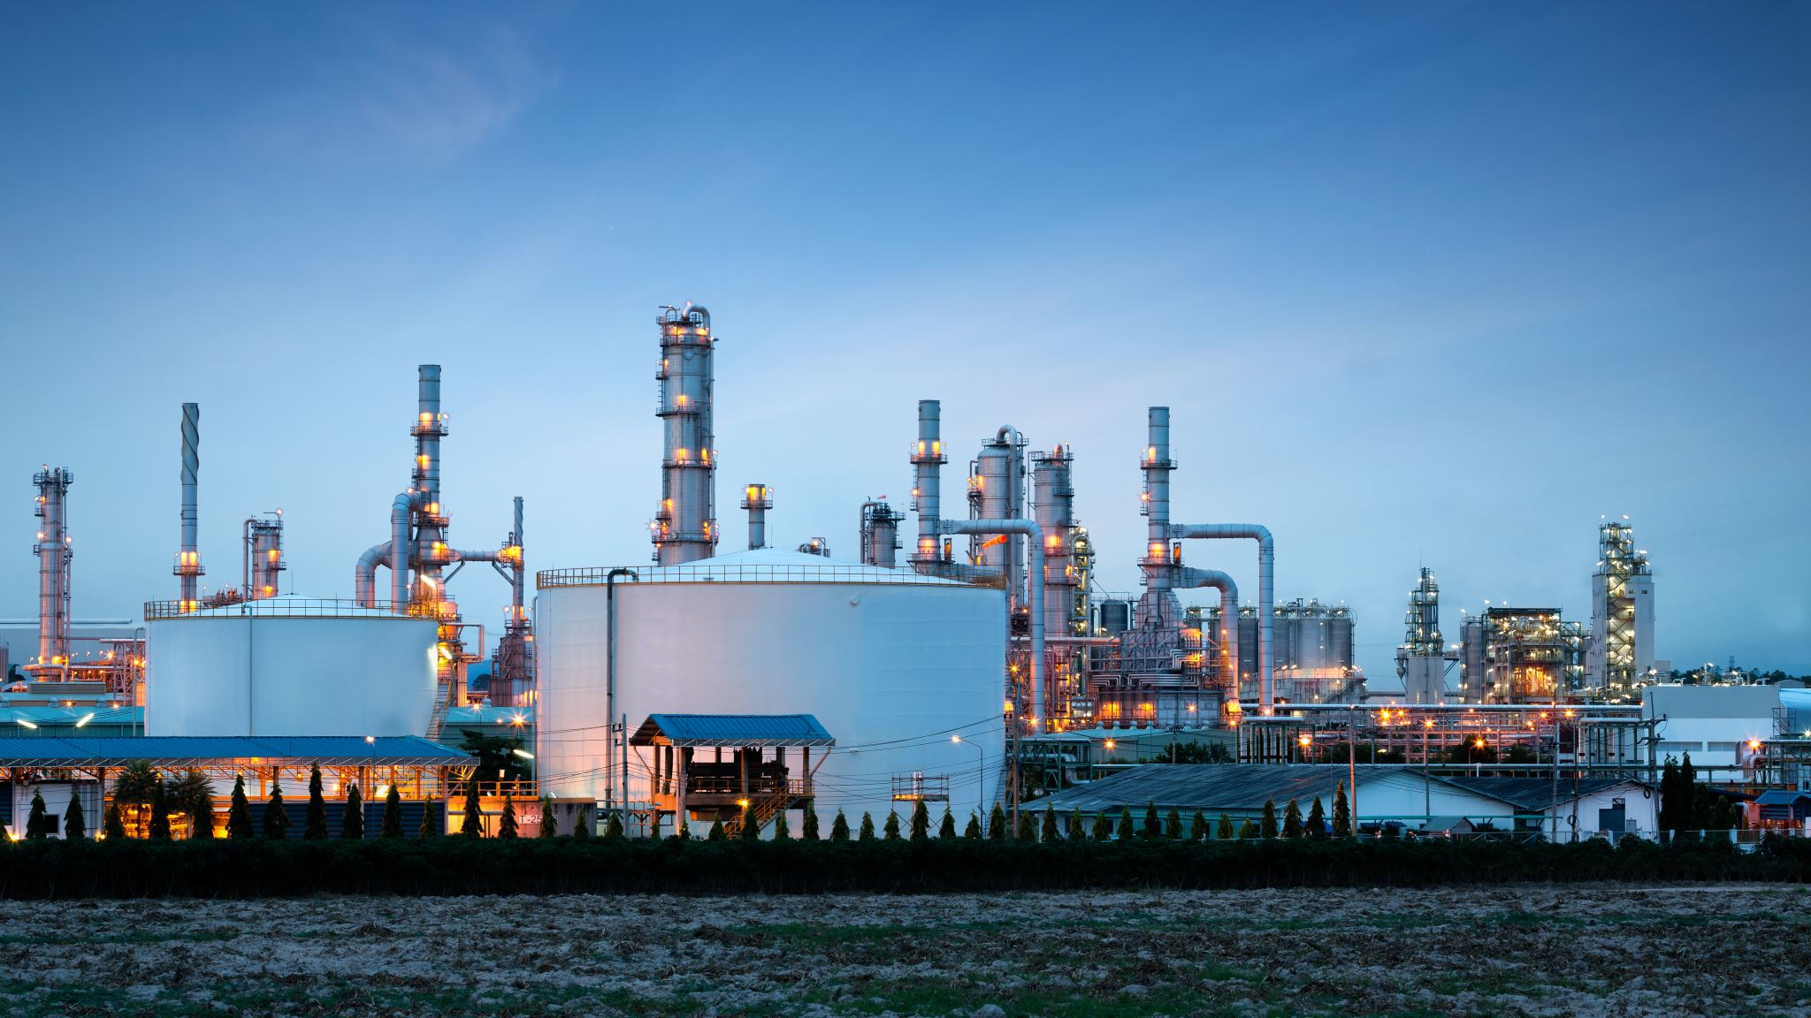
“Demand and supply of oil and gas”
Made by Sohaib Sarosh Shamsi

Slide 2
Demand
Transportation
Industry

Slide 3
Table of Content
While Covid-19 related delays are among the key reasons cited by producers behind lower production, India's crude oil and natural gas production have been falling consistently since 2011-12
Global demand for crude oil (including biofuels) in 2020 fell to 91 million barrels per day and is projected to increase to 96.5 million barrels per day in 2021
The Organization for Petroleum Exporting Countries reports that there are 1.5 trillion barrels of crude oil reserves left in the world. These are proven reserves that are still capable of being extracted by commercial drilling
The oil industry was already struggling before the pandemic struck, with a weakened global economy decreasing demand for energy and producers flooding the market with cheap fuel.

Slide 4

Supply AND DEMAND
SUPPLY | DEMAND
Fossil fuel reserves | Making roads, pharmaceutical industry
Underwater oil reserves | Transport Cars jets
Gas Fields | Thermal power station electricity Houses factories

Slide 5
Graph

